Slide 1
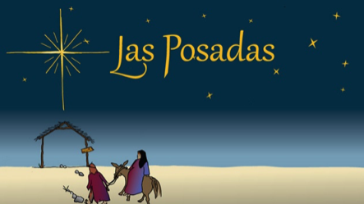

Human Relations, Diversity & Equity
Student Support and Attendance Services

Slide 2
Would you rather...
Explore space
Explore the ocean

Slide 3
Objectives
Learn about Las Posadas
Learn the traditions of the holiday

Slide 4
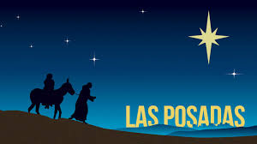
What is Las Posadas?
Las Posadas is a novenario (an extended devotional prayer)
It is celebrated chiefly in Latin America, Mexico, Guatemala, Cuba, Spain, and by many Latinx people in the United States.
It is typically celebrated each year between December 16 and December 24.

Slide 5
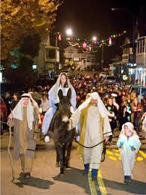
The Re-enactment
Posada means "lodging"
It lasts 9 days to represent the 9 months of pregnancy of Mary, the mother of Jesus
It is a re-enactment of the Christian story of the nativity and the journey to find lodging so Mary could give birth to Jesus.
Two people dress up as Mary & Joseph and certain houses are designated "inns".

Slide 6
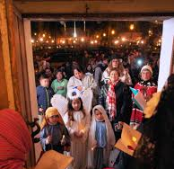
The Re-enactment
The actors travel to one house each night for nine nights.
At each house, the resident responds by singing a song and the pair are recognized and allowed to enter; the group of guests come into the home and kneel around the Nativity scene to pray (typically, the Rosary).
The final location may be a church instead of a home.

Slide 7
Time To Share
Are there any cultural traditions that your family/ culture participate in like Las Posadas?
If so, what is it? How is it similar or different?

Slide 8
The Traditions
During Las Posadas followers who are taking part may dress as angels and shepherds, joining along the way
Children carry poinsettias
Musicians sing throughout the entire procession, including "Pedir Posada" (request lodging)
At the end of each night, there is a feast for all and a star shaped pinata is broken.

Slide 9
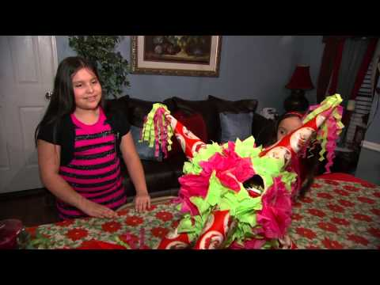
Las Posadas
Notes:
Play the video 4:04
Las Posadas: Welcoming Jesus (UMTV) - YouTube

Slide 10
Time to Share
What is something you learned from this presentation?

Slide 11


Which is better?

Slide 12
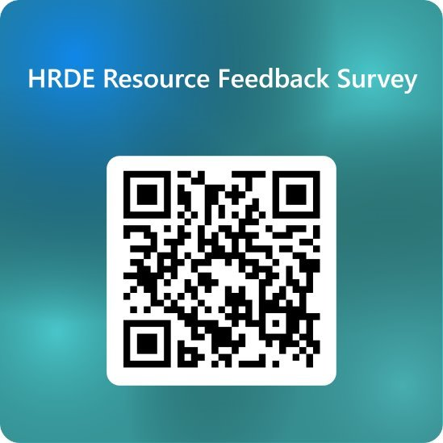
Teacher Feedback Survey
Notes:
Teacher, please scan the QR code to complete a brief feedback survey:

Slide 13
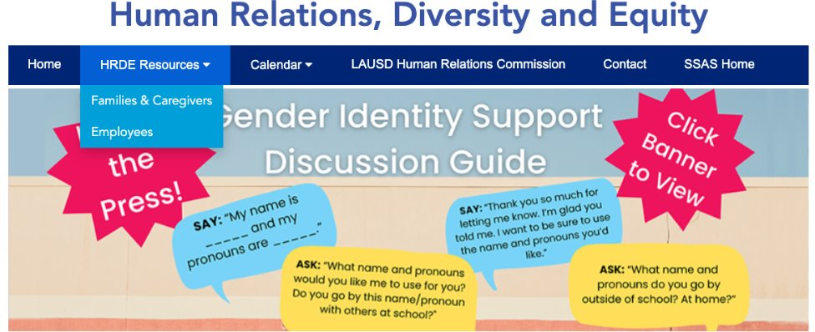
For additional resources, visit us at: https://www.lausd.org/human-relations

